Slide 1
Compression of surface properties of TVMs
Jan Dvořák, Libor Váša

Slide 2
The data
TVMs
Time-varying meshes
Time series of meshes
Different geometry in each frame (vertex positions)
Different connectivity in eacch frame (triangles)
=> different mesh in each frame (but similar shape!)
Typically: scanned moving people
Aim at generality

Slide 3
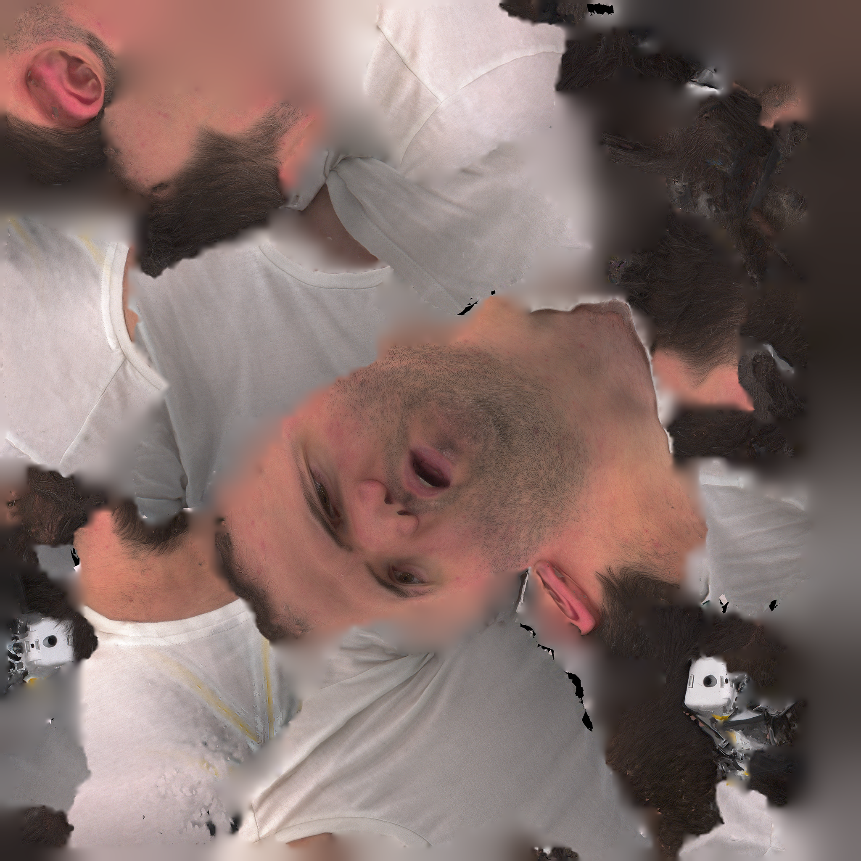
Problem
Surface color
Texture in each frame
Different UV coordinates for each frame
Different texture image for each frame
=> lots of data, lots of coherence, no way to exploit it
No temporal correspondence

Slide 4
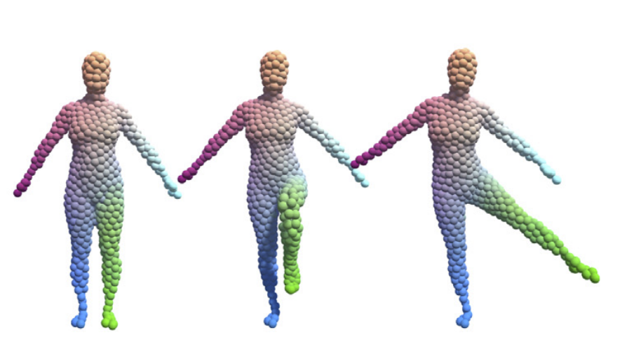
Tool for solution
Tracked volume centers
Distributed uniformly in first frame
Tracked frame by frame
Criteria:
Uniform distribution in volume
Nearby centers move together in some sense
Research finished and published
Dvořák, J., Káčereková,Z., Vaněček,P., Hruda,L., Váša,L.: As-rigid-as-possible volume tracking for time-varying surfaces, Computers and Graphics, vol. 102, 2022.
Dvořák,J., Hácha,F., Váša,L.: Global Optimisation for Improved Volume Tracking of Time-Varying Meshes, In International Conference on Computational Science (pp. 113-127), Cham: Springer Nature Switzerland, 2023.

Slide 5
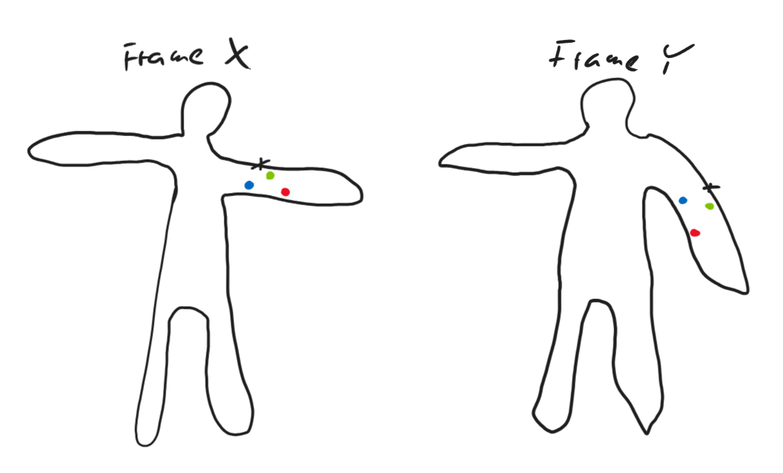
Idea
Relative position of a vertex w.r.t. centers is a temporally consistent position descriptor
Feature vector: gaussians of distances to centers
In frame X
In frame Y
N
Completely different vertices

Slide 6
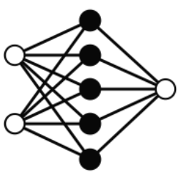
A bit of deep learning
Feature vectors
(from one or all frames)
Colour

Slide 7
Applications
Texture representation/compression
Transmit ANN weights + center trajectories
Pixel -> feature vector -> ANN -> color
No need for Uvs, no need for textures
Propagation of texture from one frame to others
Draw color on one frame
Learn ANN
Ask ANN for colours on other frames

Slide 8
Results
Highly preliminary

Slide 9
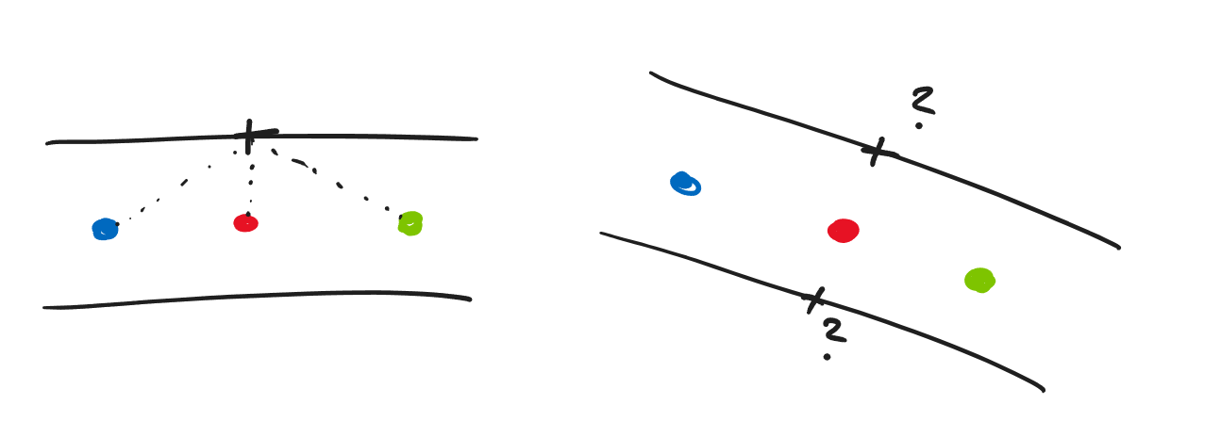
Open question
How to represent the relative position of a vertex (or texel) w.r.t. set of centers
(inverse) Distances may be insufficient
Somehow incorporate direction towards center
Must be translation/rotation invariant!

Slide 10
Conclusion
Work in progress
Any input welcome
Questions?

