Slide 1
Multichannel EEG compression using COMPROMISE
Duc Thien Pham, Josef Kohout, Ivana Kolingerova,
Pavel Šnejdar, …
Department of Computer Science and Engineering
Faculty of Applied Sciences
University of West Bohemia

Slide 2
1. DATASET
Multichannel EEG compression using COMPROMISE
2. METHOD
3. DISCUSSION

Slide 3
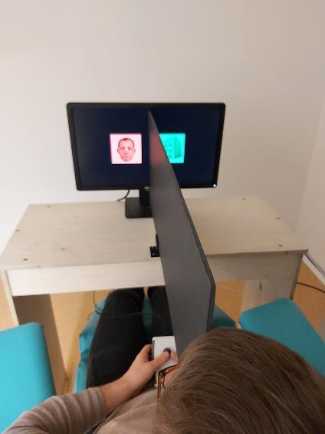
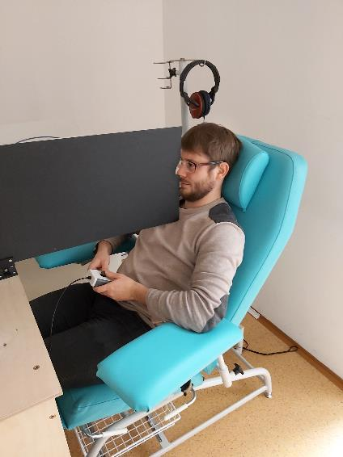
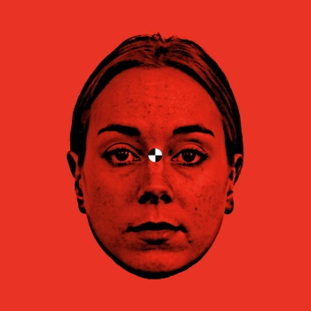
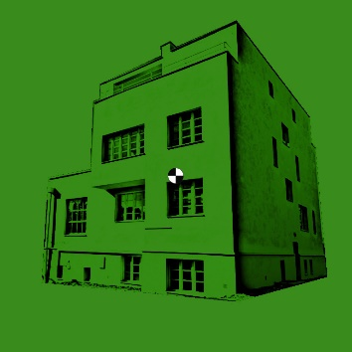
1. DATASET
Multichannel EEG compression using COMPROMISE
NUDZ dataset:
25 subjects
Face and house stimuli
EEG signal (256 electrodes)
Binocular rivalry

Slide 4
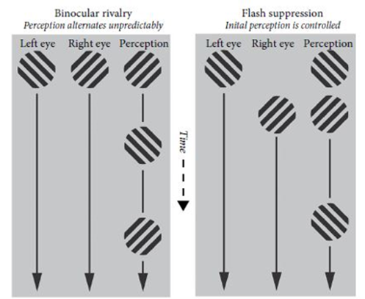
1. DATASET
Multichannel EEG compression using COMPROMISE
Experiment
Training - Replay |  |  |  | Flash suppression - Binocular rivalry |  |  |  |  | Experiment
Trials | Nonriv | Rest | Total | Trials | Rest | Non | Flash/Br | Total | Total | Min
80 | 5 | 4 | 720 | 50 | 4 | 2 | 20 | 1300 | 2020 | 33,67

Slide 5
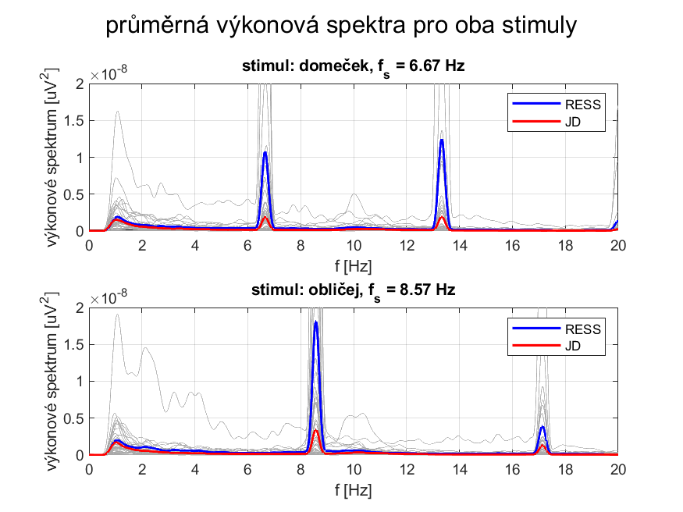
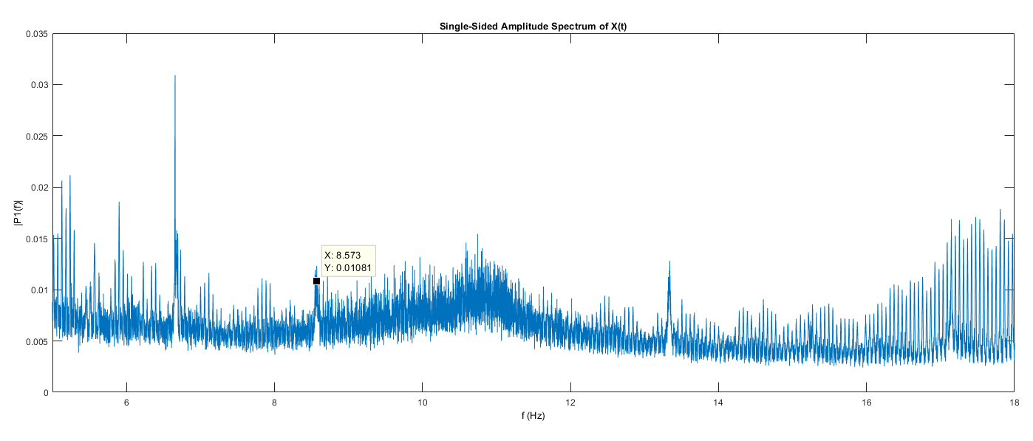
1. DATASET
Multichannel EEG compression using COMPROMISE
Stimulus frequency tagging
Face: 8.57 HZ
House: 6.67 HZ

Slide 6
1. DATASET
Multichannel EEG compression using COMPROMISE
Description of marks in the EEG recording
Marks | Description | Target/Non target
begi | Start of experiment or block
HRep | Presentation of the house in the replay block | Target
FRep | Presentation of the face in the replay block | Target
RFix | Fixation cross in the replay block
Hous | Report subject - I see a house | Target
Face | Report subject - I see a face | Target
Neut | Report subject - undefined content
SFix | Fixation cross in flash suppression block
SEnd | End of the trial in the flash suppression block
Hrs1 | House on the right as the first stimulus
Hrs2 | House on the right as second stimulus (flash suppression)
Hls1 | House on the left as the first stimulus
Hls2 | House on the left as second stimulus (flash suppression)
Frs1 | Face on the right as the first stimulus
Frs2 | Face right as second stimulus (flash suppression)
Fls1 | Face left as first stimulus
Fls2 | Face left as second stimulus (flash suppression)

Slide 7
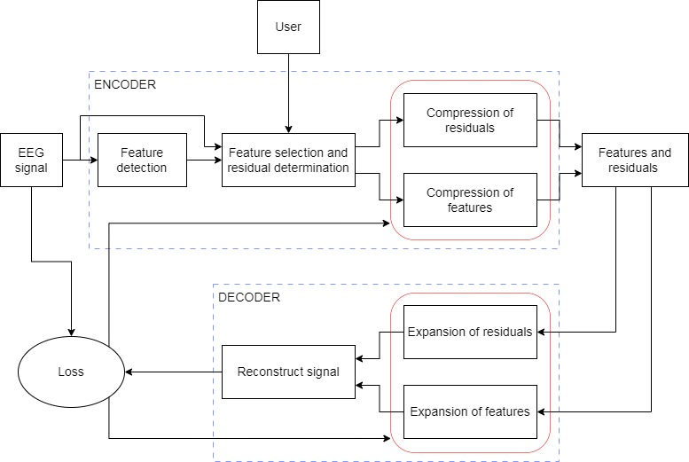
2. METHOD
Multichannel EEG compression using COMPROMISE
2.1. Proposed method

Slide 8
2. METHOD
Multichannel EEG compression using COMPROMISE
2.3. Encoder
Feature Selection and Residual Determination:
Use feature selection techniques, such as filter, wrapper, or embedded methods, to rank and select channels based on their contribution to discrimination between house and face stimuli.
Reduce the size of the data by encoding the difference (residuals) between the original EEG signal and the predicted values based on the selected features.
Compression of Residuals and Features:
Apply a compression algorithm (like ZPAQ or Fourier, Wavelet Transform) to both the residuals and selected features.
The compression process aims to reduce the size of the data representation while retaining critical information for face and house classification.

Slide 9
2. METHOD
Multichannel EEG compression using COMPROMISE
2.2. EEG processing
Filtering: Apply bandpass filters to isolate frequency bands. Filtering can help remove noise and artifacts.
Downsampling (if needed)
Feature Extraction:
Time-Domain Features: Extract statistical measures such as mean, variance, skewness, and kurtosis from the EEG signal within each epoch.
Frequency-Domain Features: Apply Fourier transforms to analyze frequency components.

Slide 10
2. METHOD
Multichannel EEG compression using COMPROMISE
2.4. Decoder
Expansion of Residuals and Features: Decompress the residuals and features to reconstruct the compressed representation.
Reverse Channel Reduction (if applicable):
Reconstructed signal: Utilize the expanded residuals and features to reconstruct the original EEG data.
2.5. Loss
A loss function compares the reconstructed signal to the original signal to update the weights of both the compression and the expansion at the same time.
Using Mean Squared Error (MSE).

Slide 11
3. DISCUSSION
Multichannel EEG compression using COMPROMISE
…

Slide 12
Multichannel EEG compression using COMPROMISE
Thank you for your attention

